Slide 1
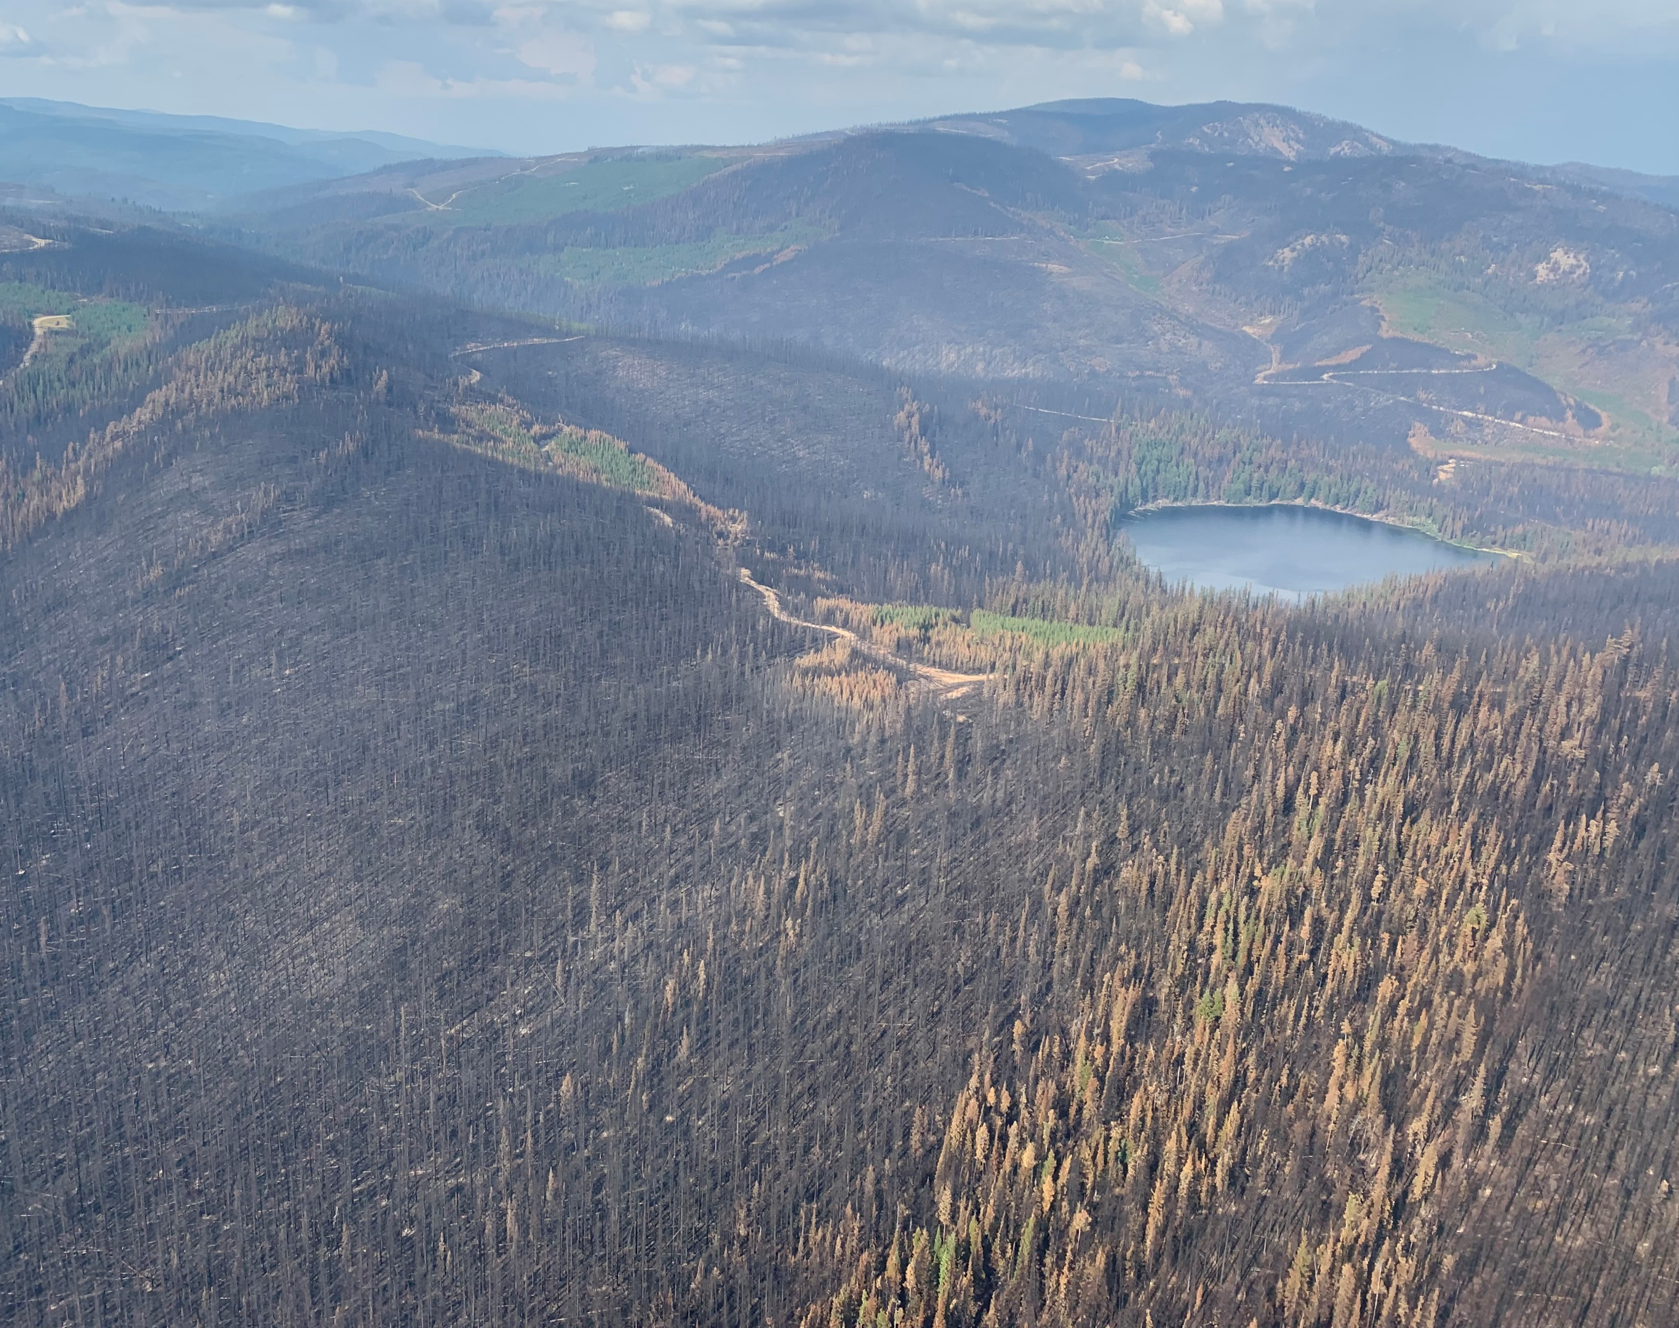
Garrison Fire Overview
Oct 20, 2021 Update

Slide 5
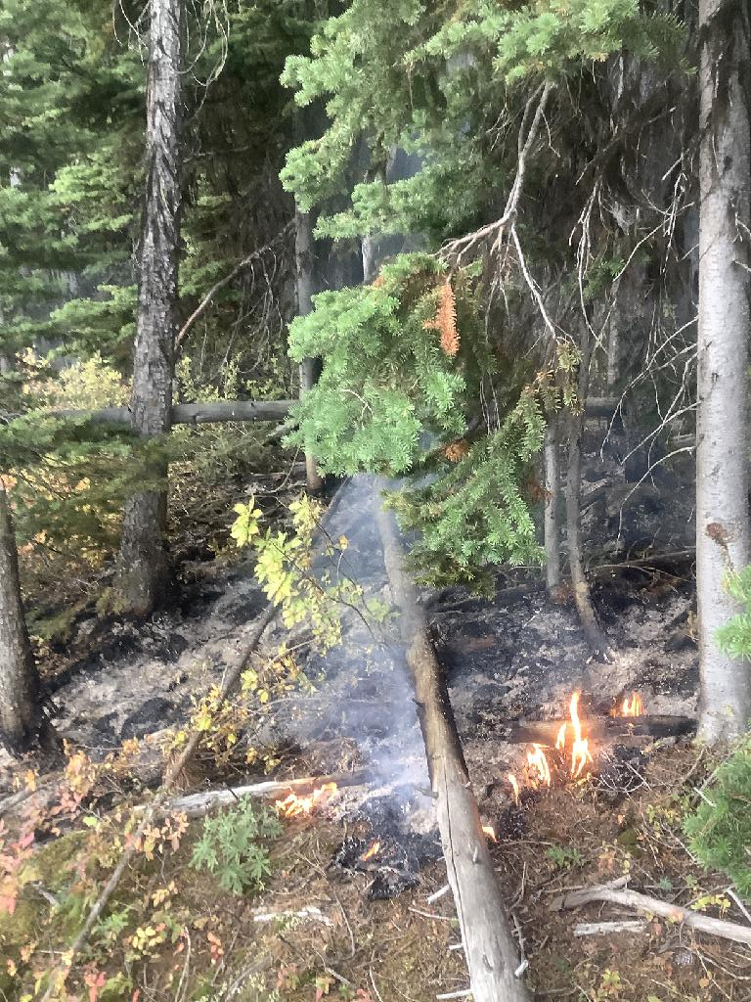
Field work commenced Sept 8th
  Fire was still burning
  Area restriction in place (worked under variance)
One of 4 Fires Weyerhaeuser is involved with:
  Thomas
  Nk’mip
  Cool Creek
  Garrison
Several initiatives ongoing to look at principles (including Merritt TSA Steering Committee)…none far enough along to have provided specific principles.

Slide 6
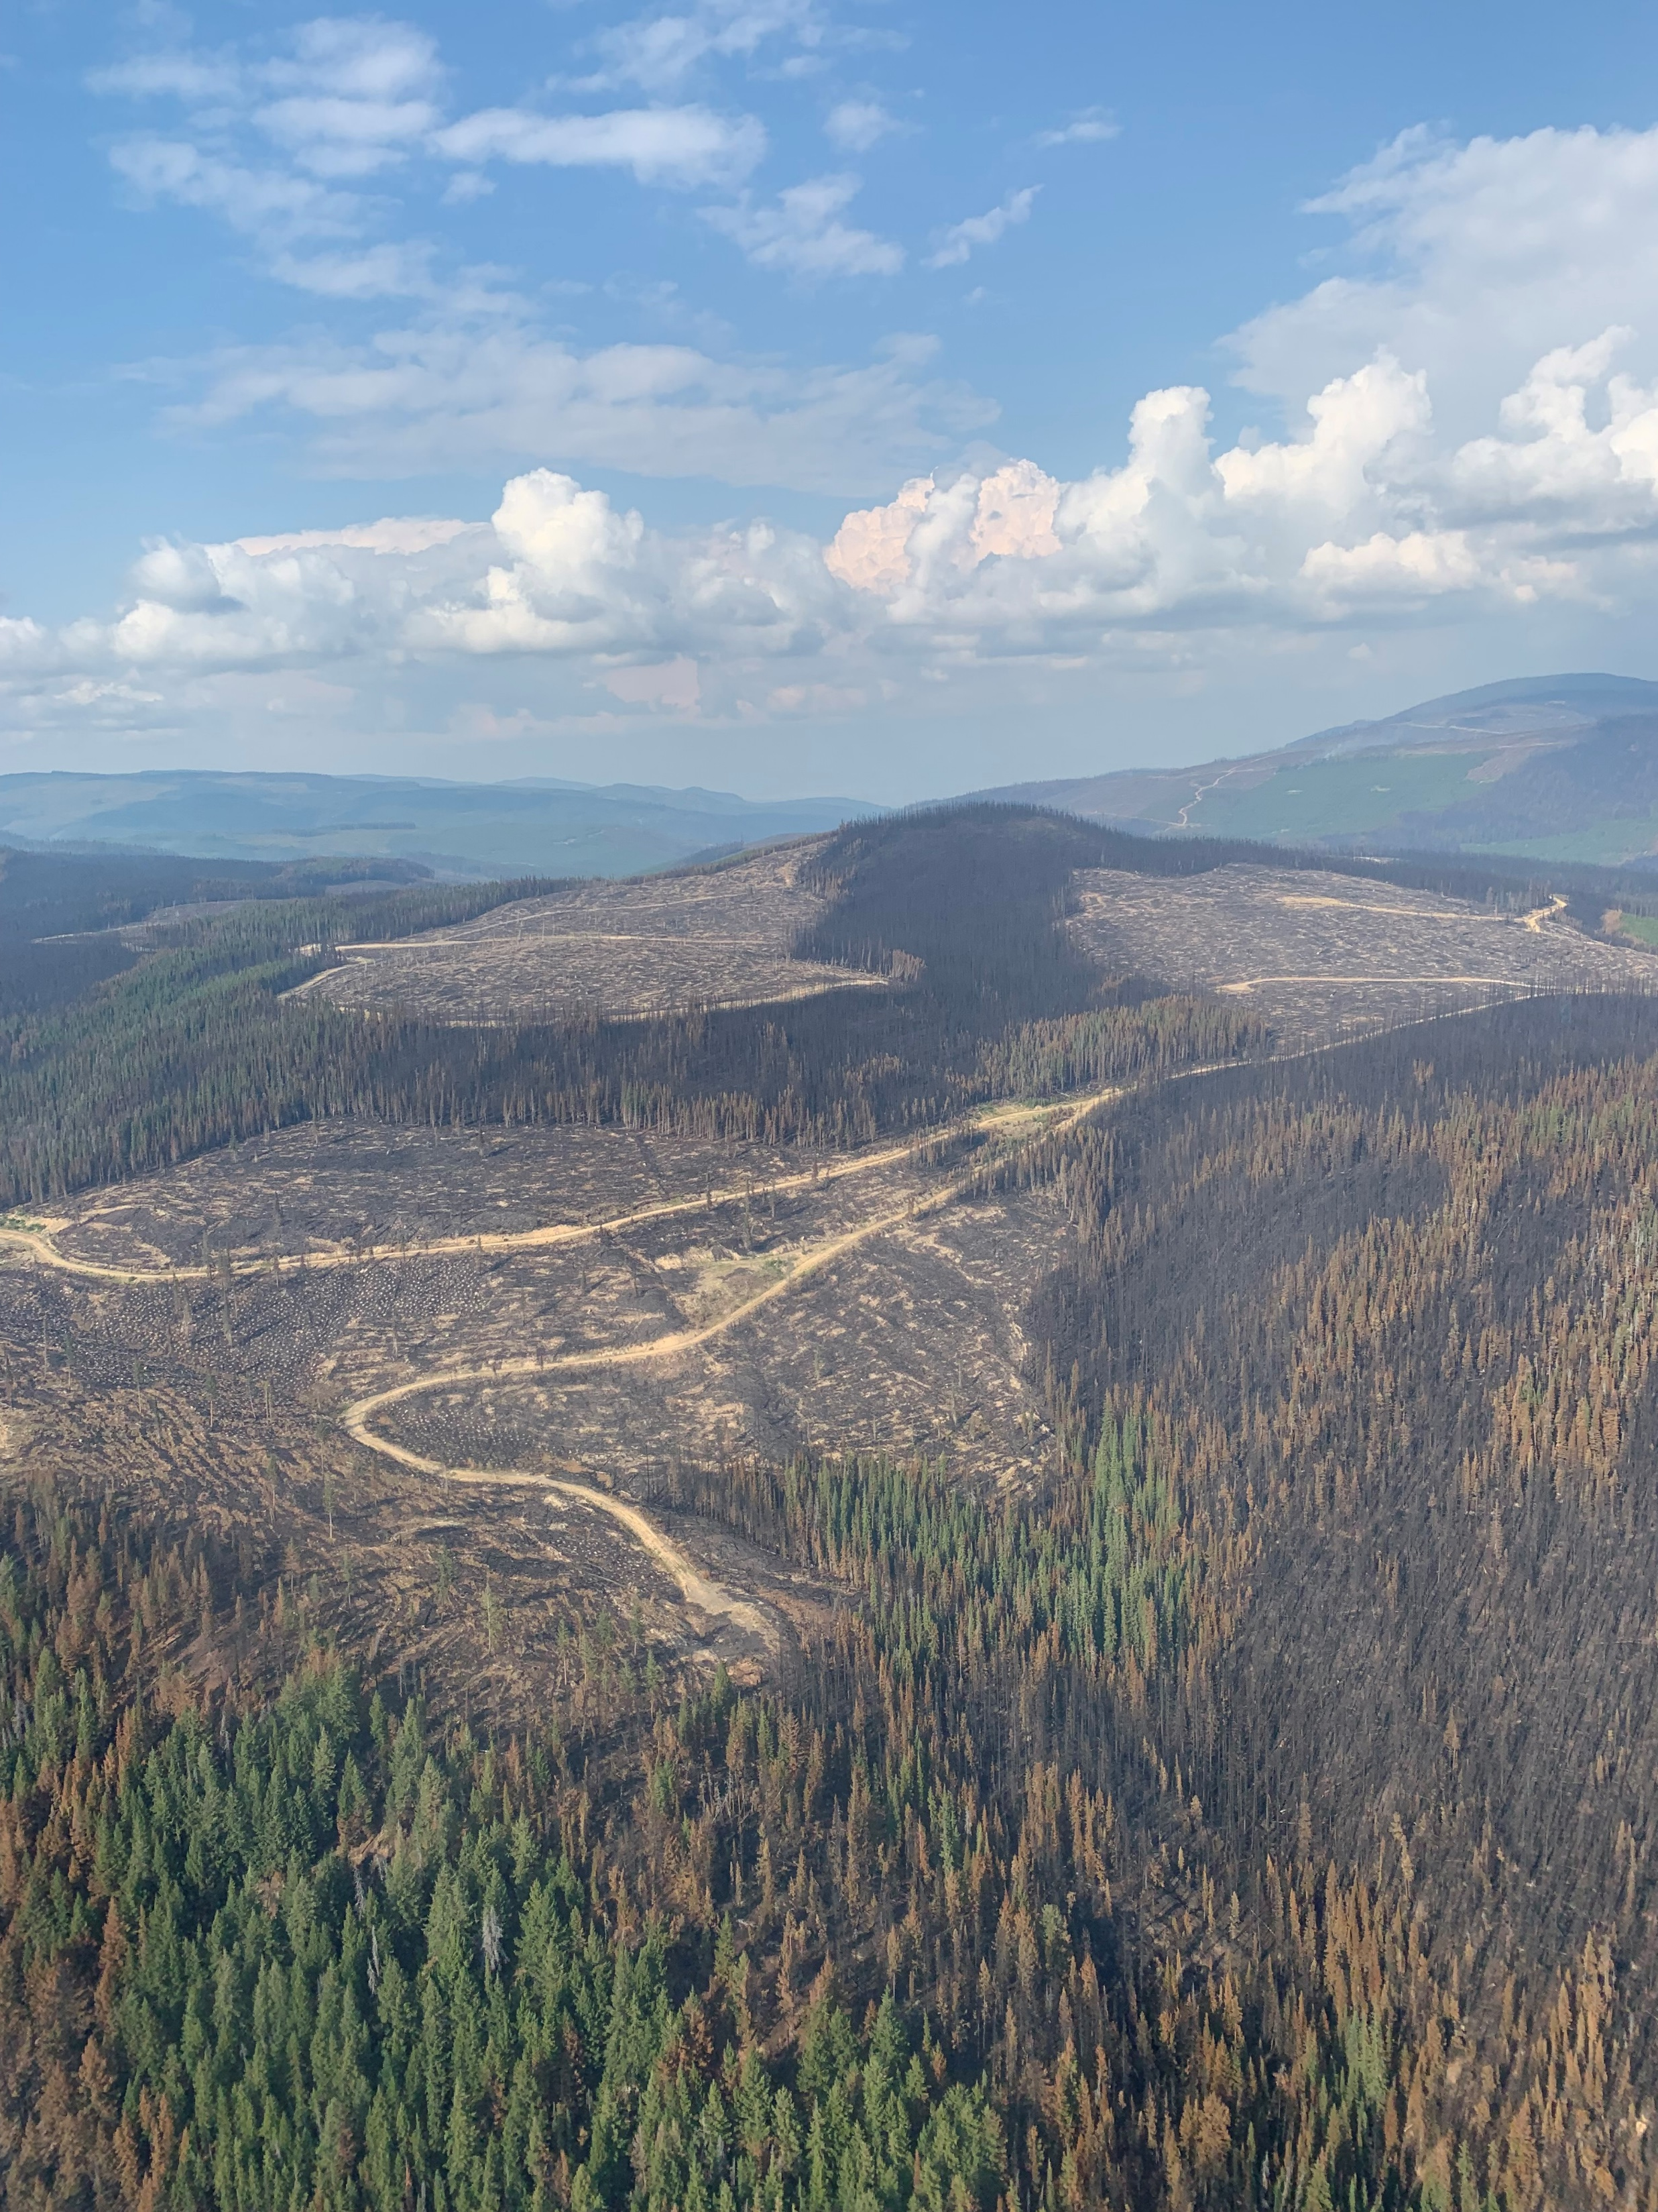
Weyerhaeuser adopted principles for development/layout we believe are aligned:
  What we have heard to date in Committees
  Past or Recent discussions with First Nations
  PFR Reports and recomendations
  Chief Forester Guidance on Wildfire Recovery
  Elephant Hill Principles
  Past Hydrological Assessments

Slide 7
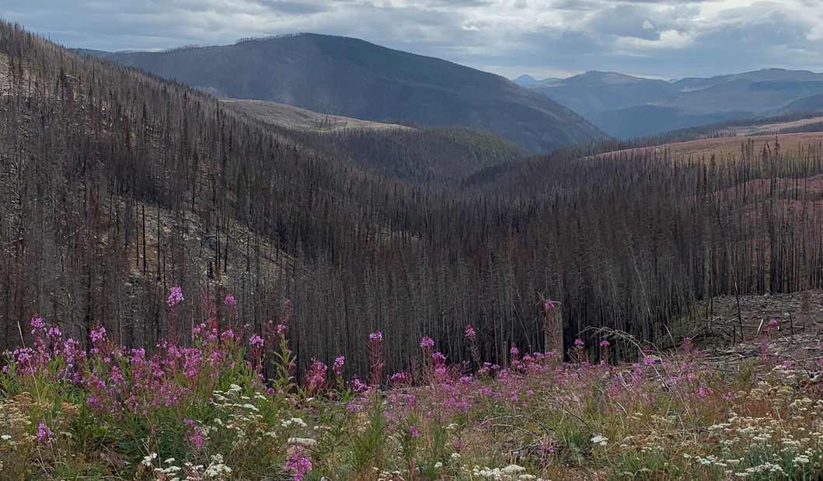
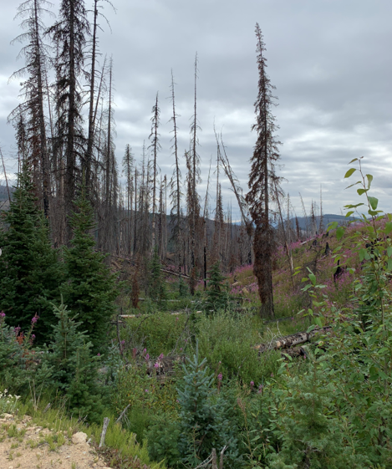
Examples of Principles:
  Exclude green – if it is likely to live, it stays.
  RMA is reserved
    S6 = 20 m each side
    S4 = 30 m each side
    etc
  Significant NCDs = 10 m reserve each side
  Stay away from Unstable or Potentially Unstable Terrain
  WTR / In-block retention
    Even if burnt (sub-merch too)
    Single dispersed trees where safe to do so
    Strive for distribution
    Exceed FRPA minimums
    Consider unburnt timber where possible; riparian areas; wildlife features; etc.
Above: Larger draws/gullies with full reserve (2018 Cool Creek Fire) .
Below: Riparian retention on small features (2018 Cool Creek Fire)

Slide 8
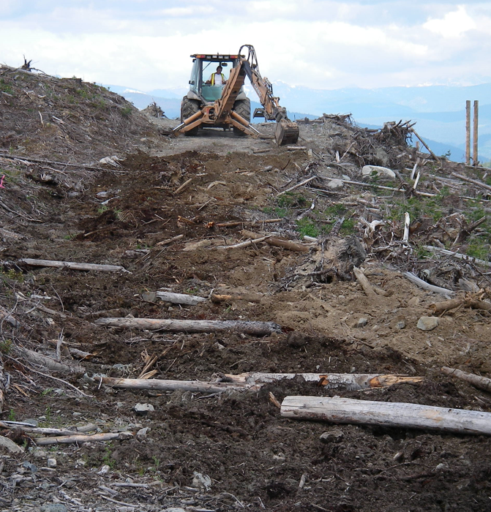
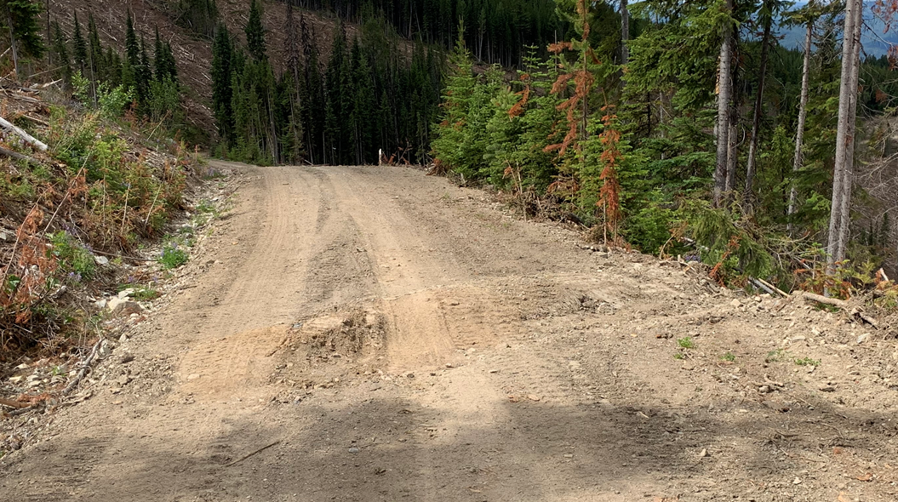
Examples of Principles (continued):
  Roads:
    Maximize use of temporary access
      Very limited reasons to build new perm
    Upsize culverts and increase frequency.
    Increase use of seasonal deactivation (waterbarring/cross ditching).
    Minimize/avoid new stream crossings.

Slide 9
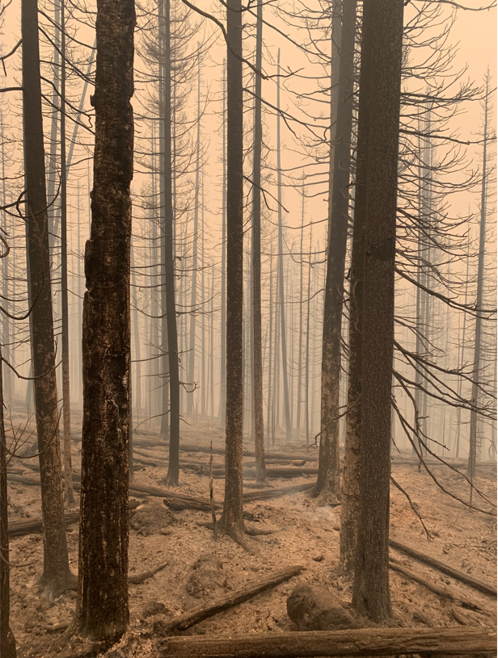
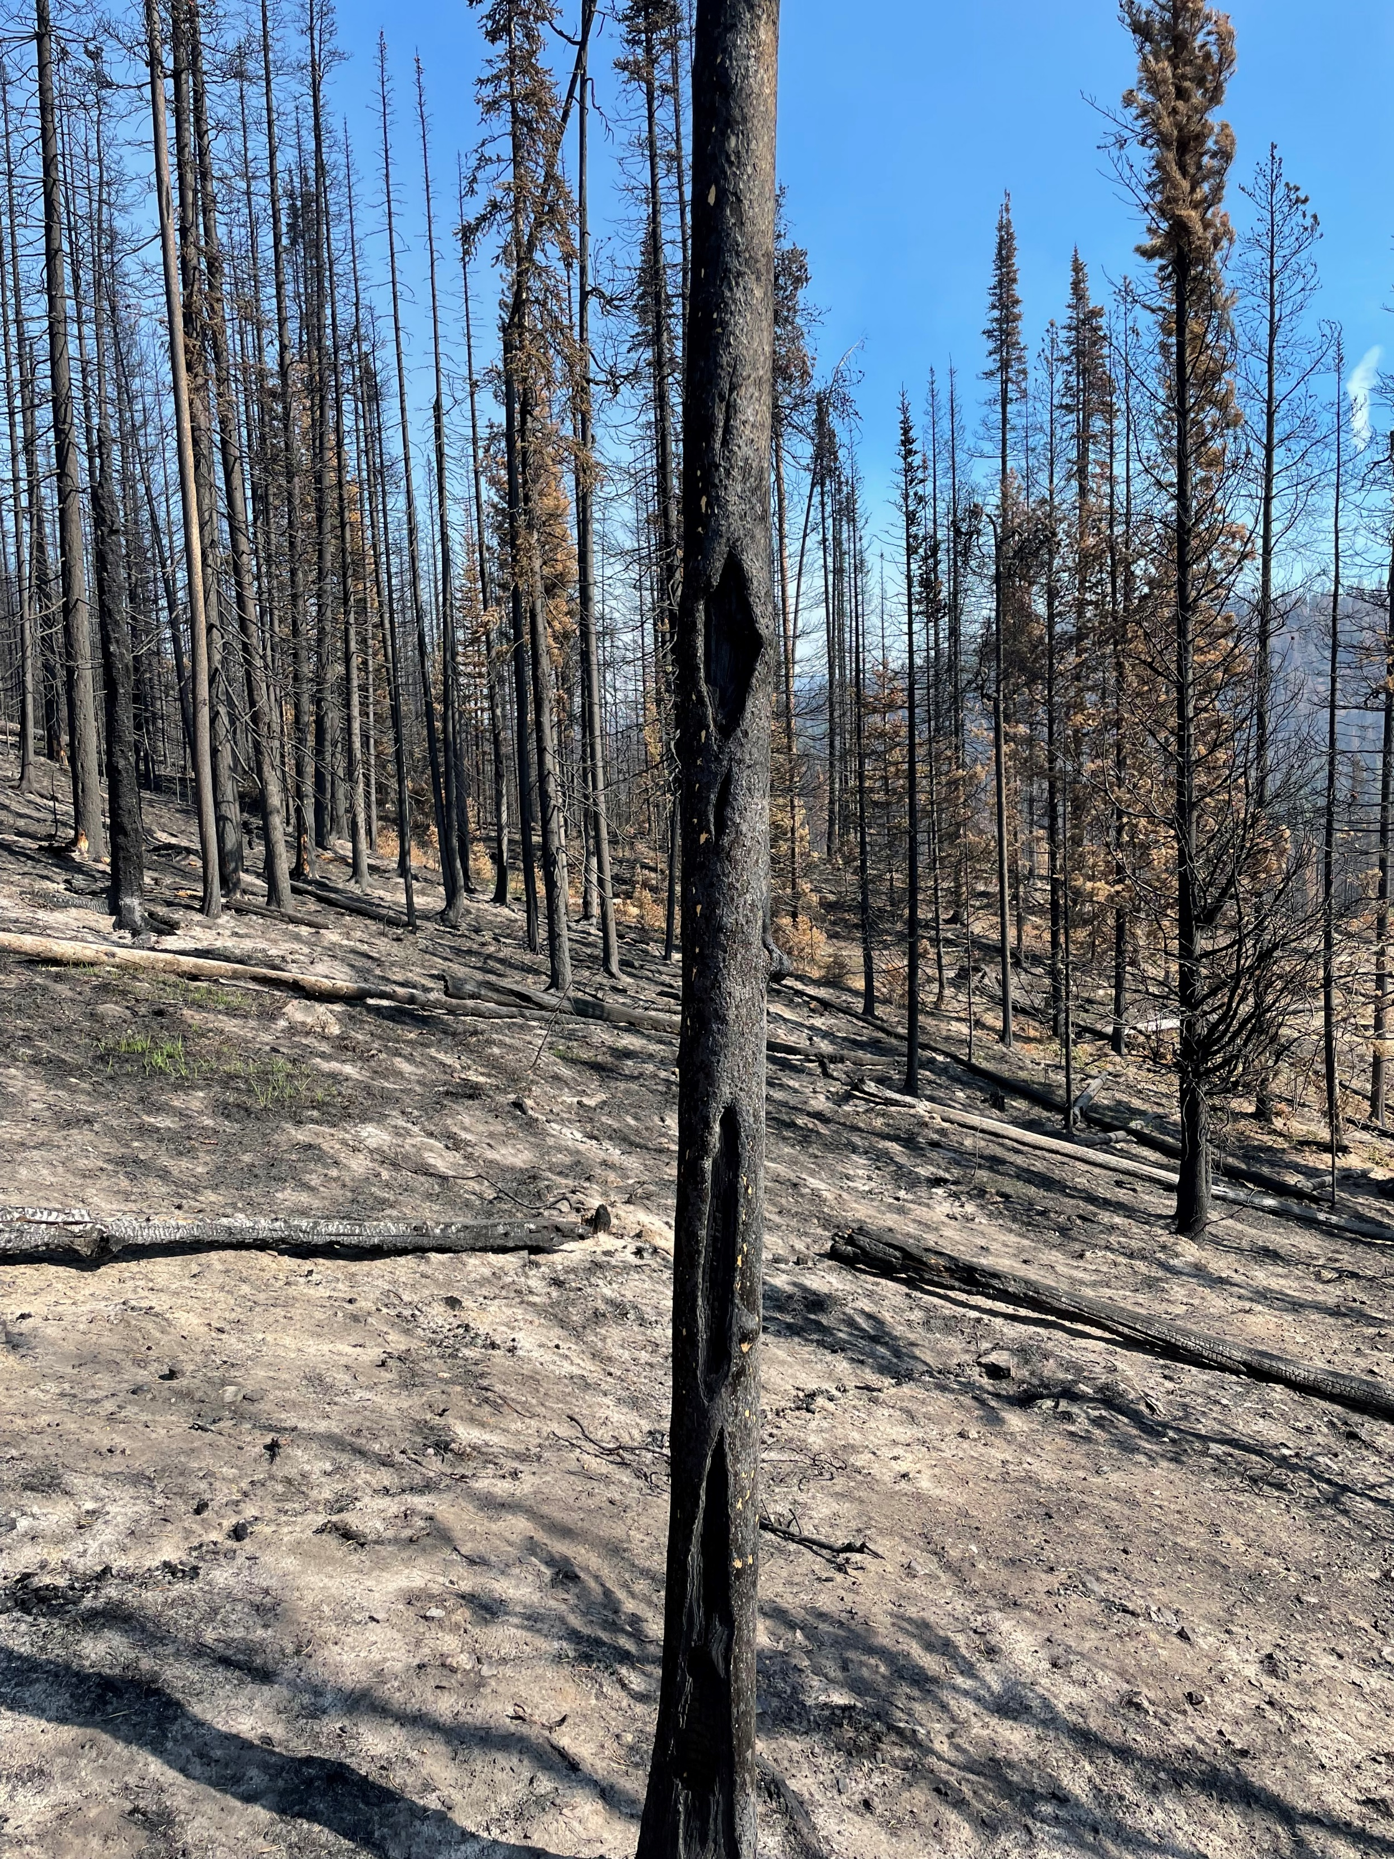
Examples of Principles:
  VQOs:
    Stay out of Preservation or Retention,
    Prioritized Partial Retention as a lower priority to develop.
  Wildlife:
    No WHAs exist in Garrison fire;
    No WISA
    Very Little UWR
    Coastal Tailed Frog
  Prioritize most severe burn first;
  To the extent possible, leave green STI elsewhere in TSA in favor of harvesting more salvage.

Slide 10
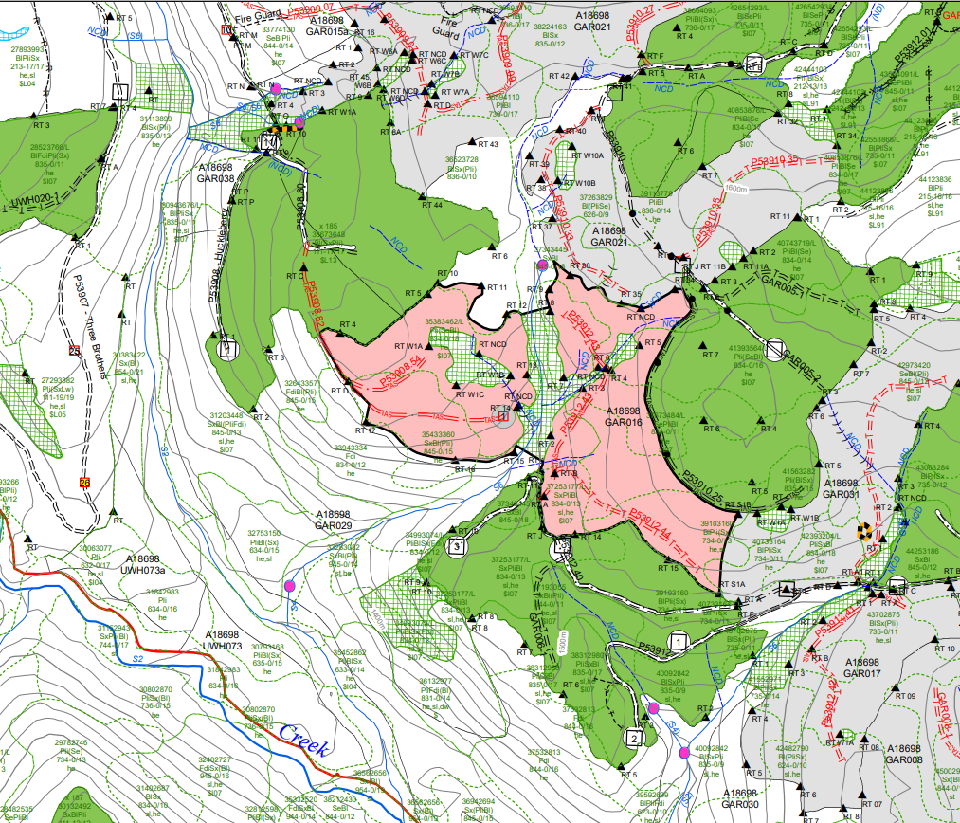
Examples of Result:
  Stream crossing avoided.
  ALL temp roads
  RMA reserved
  Reserve on NCD.
  Steep slopes excluded
  WTR patches and exceed FRPA.

Slide 12
